Slide 1
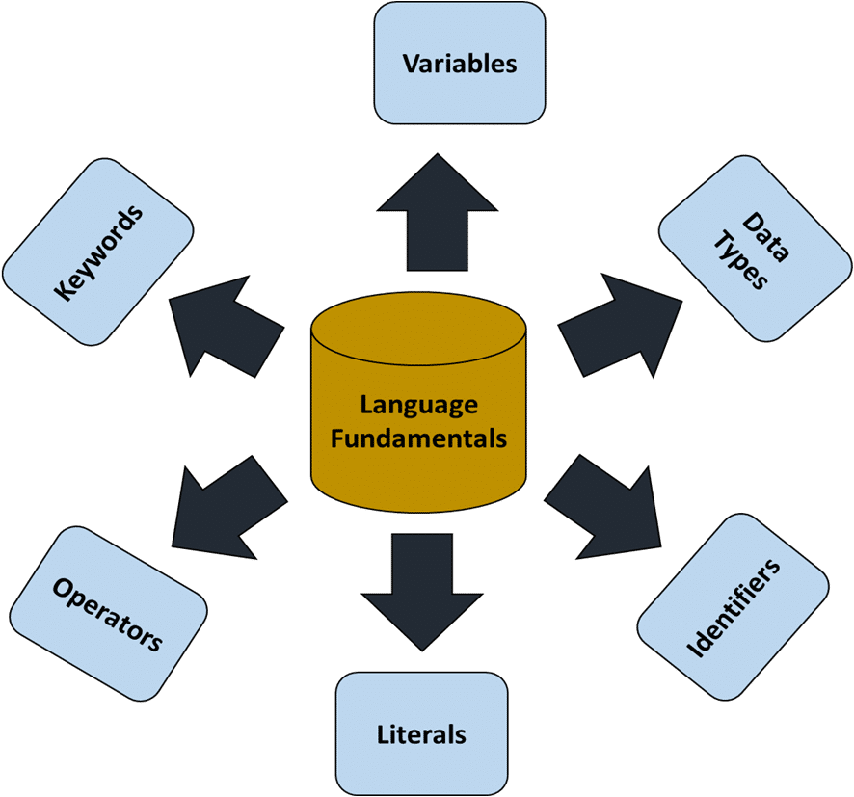
Language Fundamentals
Chapter 02

Slide 2

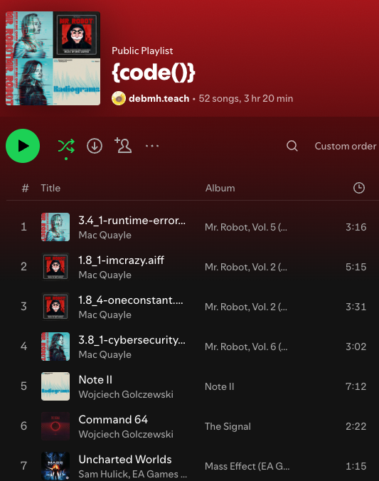
Canvas and Teams
Check in
Survey - I have not finished looking at the surveys
Team Collaboration CS1050 Deb Harding | General | Microsoft Teams
Book - https://runestone.academy/ns/books/published/csjava/index.html?mode=browsing
Goals:
Utilize appropriate data types, expressions, assignments, and variables
Explore Code
Review Environment Setup - Eclipse, Git and Github
What music do you like to listen too when you are coding?

Slide 3
Goals
Taking notes
Variables, Constants, and Data Types
Explain and apply in code the concepts of variables, constants, primitive data types, declared, initialize, and assignment
Apply best practices industry convention for naming variables, constants, methods and classes
Arithmetic Operators and Combined Assignment Operators
Identify arithmetic operators
Describe combined (augmented) assignment operators and use in code
Apply precedence rules when evaluating arithmetic expressions perform mathematical operations in code
Communication and Collaboration
Engage in professional, clear and effective communication virtually in class and discord

Slide 4
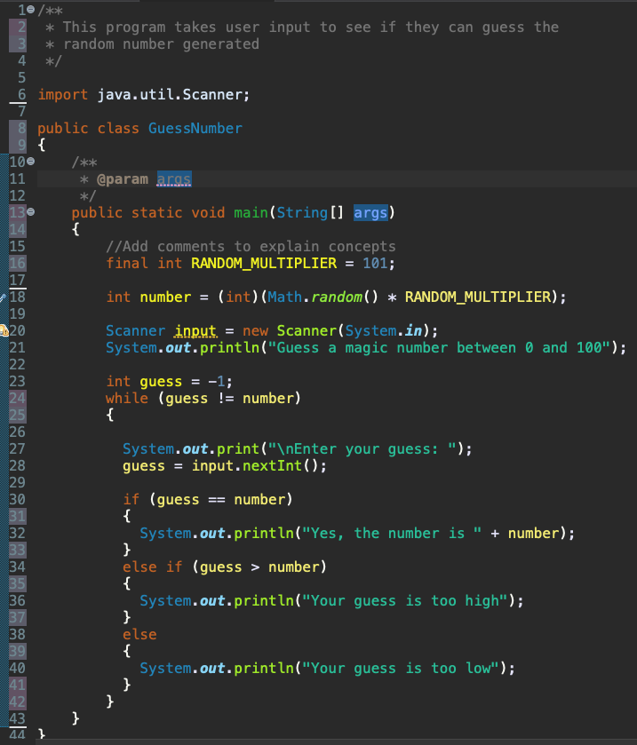


Java Program Example
How is information stored when running a program?
Where is information stored?
What type of information is stored?
What are variables and constants?
What are identifiers?
What are naming conventions?
What are data types?
What are literals?
What does it mean to declare a variable?
What does it mean to initialize a variable?
Share what you think.
Ask questions

Slide 5
Identifiers
An identifier is basically a name chosen by the programmer for: Classes, Methods, Variables, Constants
Identifiers follow certain rules
Consists of letters, digits, underscores (_), and dollar signs ($)
Must start with a letter, an underscore, or a dollar sign
Can be any length
Cannot be a reserved word
Cannot be the words true, false, null (these are literal values)
Valid
sum
numberOfStudents
Java is case sensitive so sum, Sum, and SUM are 3 different identifiers
Invalid
7_students
#OfStudents

Slide 6

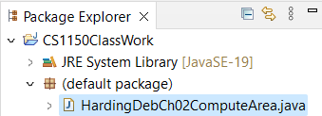
Class Identifier
Every Java program must have at least one class. Each class has a name. By convention, class names start with an uppercase letter. In this example, the class name is HardingDebCh02ComputeArea.
Next the main method is defined to perform the actions. In order to run a class, the class must contain a method named main. The program is executed from the main method.
Notice the identifier for the class starts with capital letter, is meaningful and uses camel case
File name must match class name.

Slide 7
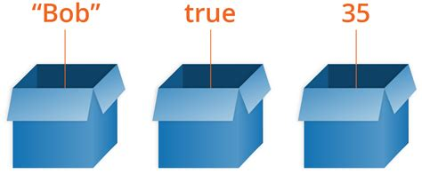
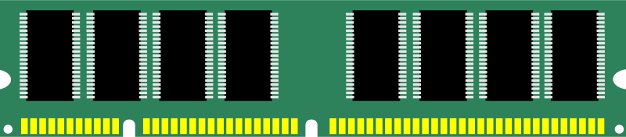
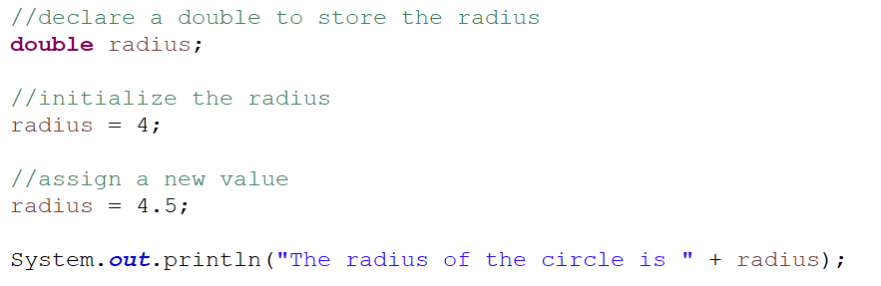
Variables
Variables are used to store a value that may change (vary)
Have a data type
Are stored in computer memory
Have scope - defines the part of the program where the variable is accessible.
What we do with variables
Declare identifier and data type
Initialize by assigning a value in memory
Assign a new value in memory
Read the value from memory
Use identifier name to assign value in memory or to read value from memory
radius
009AFD30
4
Create location in memory to with enough bytes to store a double. The memory location identifier of the variable is radius
Assign the value 4 into memory. Will be stored as a double 4.0.
Assign a new value in memory 4.5.
Get the current value from memory 4.5

Slide 8
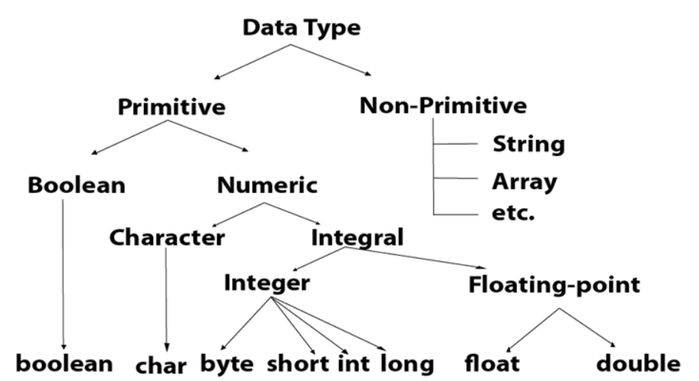
Data Type
Java Primitive Data types
Tells compiler what type of data that is stored in a variable
You must declare the type of each variable
This means assign a specific type to the variable
Strongly typed language!
This means that once you declare a variable to be a certain it will behave as that type
Type safety- you can’t put a floating-point value into an integer unless you explicitly tell it
What do you think different data types tell the computer?

Slide 9
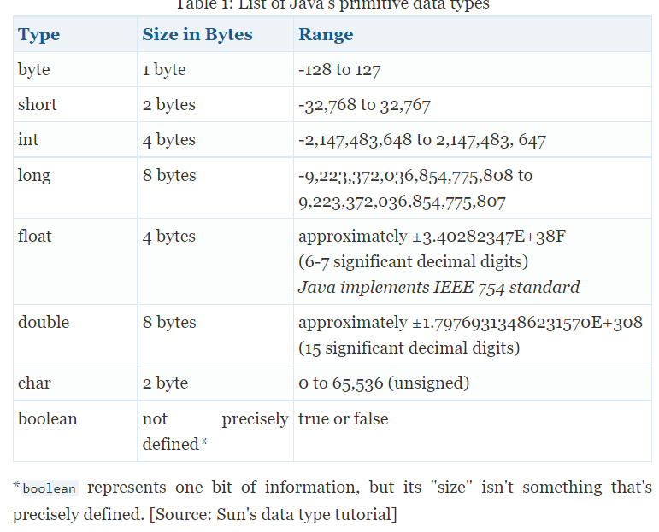

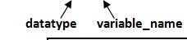
Data Types Ranges and Storage Size
When declaring a variable for a primitive data type enough memory is allocated based on the data type.
Declaring results in allocation in memory to store values of the datat type.
Java Primitive Data Types. Size, Range and Default Value of Basic Data Types

Slide 10
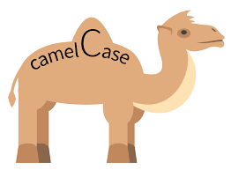
Quality Code: Variable Naming Conventions
Follow Java naming conventions and create meaningful identifiers for variables
Use meaningful names
Do not use one letter variable names
Begin with lowercase
Multiple-word identifiers use camel case
First word starts with lowercase letter
Each remaining word starts with upper case
What if I needed to create an identifier for a variable to hold the total number of students?
n | bad
NUMBER | bad
count | A little better
students | A little better
totalStudents | best
For this class

Slide 11
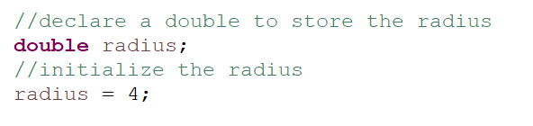
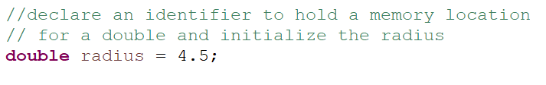
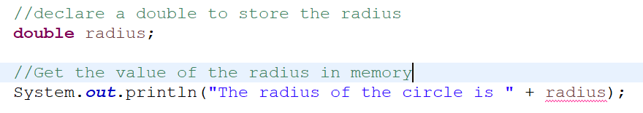
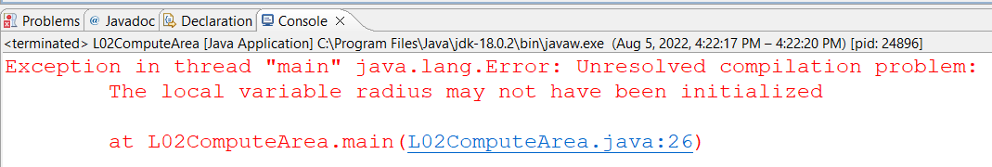
Initializing Variables
This means allocate memory to hold a double
Declare variables by defining what data type. The type determines the amount of memory needed to store the value.
Initializing a variable means to assign an initial value to it (i.e., before it is used at all).
You can declare and initialize in one step
Read as assign 4 to the radius and not radius equals 4
Error: A variable that is declared but not initialized does not have a defined value, hence it cannot be used until it is assigned a value.

Slide 12
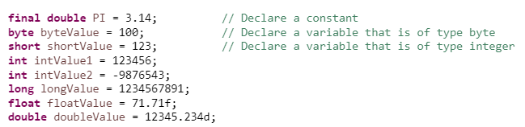
Declare and Initialize
You can declare and initialize variables in one step.
For decimal numbers if you leave off the suffix (f or d) the number defaults to a double
For this course you can use double which is the default.
If you leave off the “f” for a float would get error that says it cannot convert double to float
If you left off the “d” for a double there is no issue (which is the default)

Slide 13

Constants
Constants are used to store a value that will not be changed when the program runs. Constants can be beneficial so information is not hardcoded in the program. More on this later.
Declare and initialize using final keyword with name and data type
Enough memory will be allocated for that data type but it will be read only memory
Naming conventions:
Using meaningful names
Use all uppercase
Words separated with underscore

Slide 14
Number Literals
A literal is a constant value assigned to an integer variable. For example, 15, 1,000,000, and .05 are the number literals in the following statements:
type variable identifier assignment literal
int years = 15;
long principal = 1000000;
double rate = .05;
I declare means allocate enough memory for that data type and the memory can be accessed by the identifier name.

Slide 15
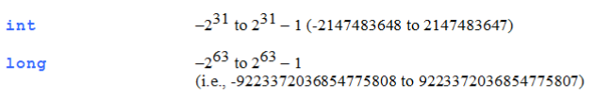
Integer Literals
Integer literals are assumed to be of type int. An integer literal can be assigned to an integer variable as long as it can fit into the variable. A compilation error would occur if the literal were too large for the variable to hold.
byte b = 1000;
long bigNumber = 2147483647;
long bigNumber = 2147483648;
You need to specify if it is a long with a suffix of “L”
long bigNumber = 2147483648L;
Error: Out of range would cause a compilation error, 1000 cannot be stored in a variable of the byte type.
Without the “L” suffix this is an int and in range of int
Error: Out of range of int
With the “L” suffix this number is a long and in range

Slide 16


Floating Point Literals
Values we assign to a floating-point variable
Floating point literals are assumed to be of type double
Can specify that a number is a float with the “f” or “F” suffix
Can specify that a number is a double with the “d” or “D” suffix - if leave off defaults to double
System.out.println("1.0 / 3.0 is " + 1.0 / 3.0);
System.out.println("1.0F / 3.0F is " + 1.0F / 3.0F);

Slide 17
Decimal Number
For decimal numbers if you leave off the suffix (f or d) the number defaults to a double
float floatValue = 71.71f;
If you leave off the “f” would get error that says it cannot convert double to float
double doubleValue = 12345.234d;
If you left off the “d” there is no issue
For this course, use double (which is the default)

Slide 18
Scientific Notation
Can specify floating point literals in scientific notation using E or e
How we write in math
123.456 => 1.23456 X 10^2
0.0123456 => 1.23456 X 10^(-2)
How to write In Java
1.23456 x 10^2 => 1.23456E2
1.23456 X 10^(-2) => 1.23456E-2

Slide 19
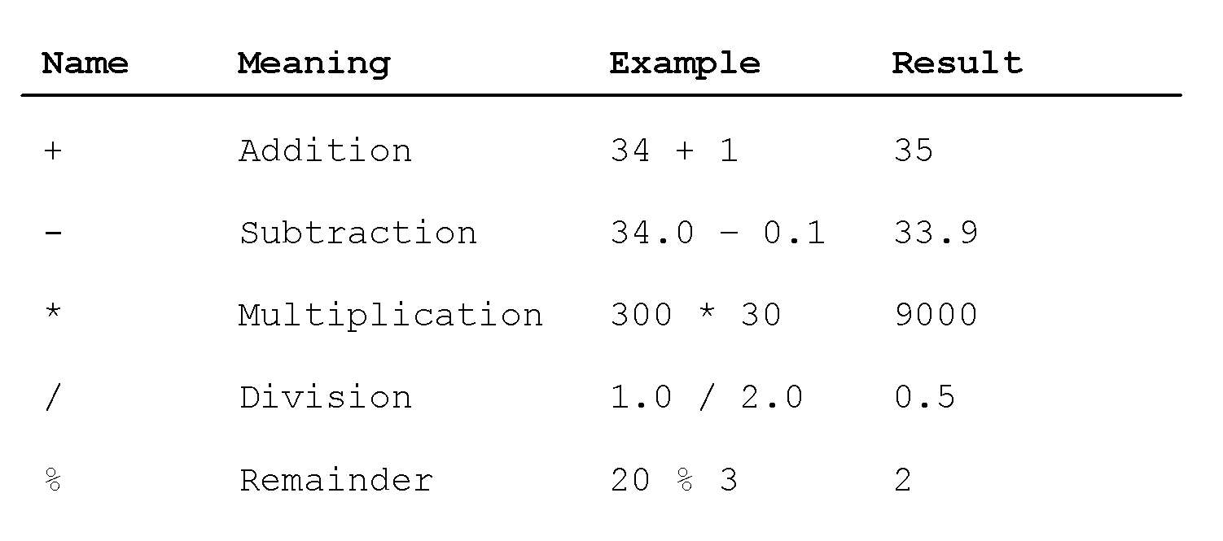
Operators and Evaluating Expressions
Recall from math the order of operators:
Parentheses
exponents
* / % (multiplication, division, remainder) from left to right
+ - (addition, subtraction) from left to rights

Slide 20

Breaks and Learning
Take Five: 51 Things to Do When You Need a Break at Work

Slide 21
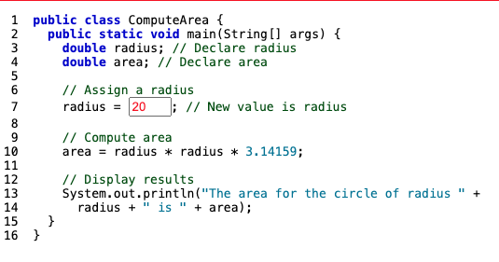
Analyze Code
ComputeArea Animation

Slide 22
Integer Division
Division with integers – be careful!
Result is an integer
Fraction part is truncated
Examples
½ is 0
17/5 is 3
Think about this when doing your assignment.
Remainder (Modulo) operator
5 % 3 yields 2 (the remainder of the division)
You can use this property to determine whether a number is even or odd.
an even number % 2 is always 0
an odd number % 2 is always 1
Read about Fun With Modular Arithmetic

Slide 23
AI Discussion and Exploration
How have you used AI? What are the benefits? What are the concerns? How can it be used in computer science?
Ask https://copilot.microsoft.com/ and https://chatgpt.com/ and https://gemini.google.com/ :
What is integer division in Java?
Discuss the different outputs. Pick the one you think gave you some useful information and ask it more questions.
Asking more questions is the key. ChatGPT vs. Microsoft Copilot vs. Gemini: Which is the best AI chatbot? | ZDNET
Review CS1050 Academic Integrity

Slide 24
Exponent Operations
To raise to a power a^b use the following method
Math.pow(a, b)
final double PI = 3.14;
double radius = 2;
System.out.println(Math.pow(2, 3));
// Displays 8.0
System.out.println(Math.pow(4, 0.5));
// Displays 2.0
System.out.println(Math.pow(2.5, 2));
// Displays 6.25
System.out.println(Math.pow(2.5, -2));
// Displays 0.16
System.out.println( PI * Math.pow(radius, 2));
// Displays 12.56

Slide 25
Evaluating Expressions
Expressions are evaluated in Java just as they are in math
Recall from math the order of operators:
Anything in parentheses
* / % (multiplication, division, remainder)
+ - (addition, subtraction)
When you have operators with similar precedence what happens?
They are applied in order from left to right

Slide 26


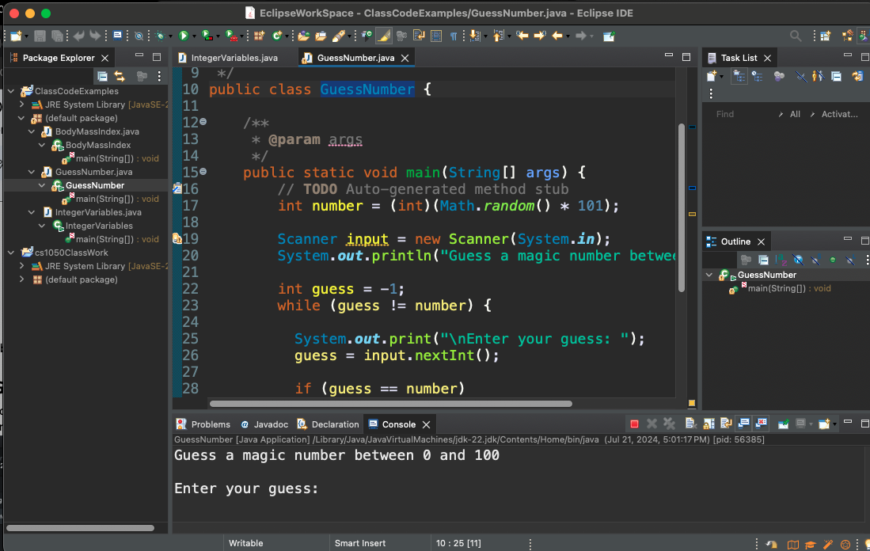


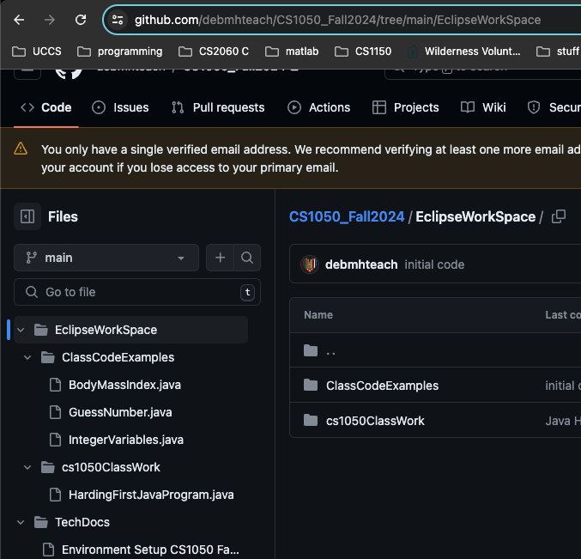
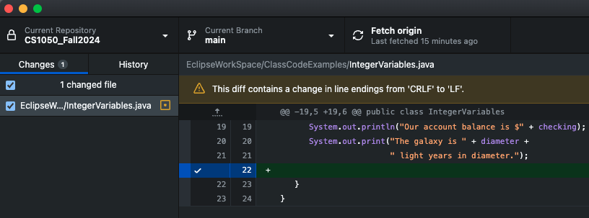
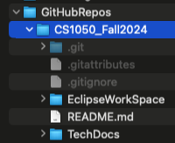
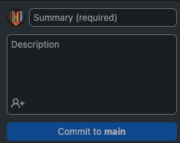
Tools: Git, GitHub and Eclipse
Develop code in Eclipse IDE and save in git repository on you local on your computer.
Use github desktop to commit and version your files and changes locally.
Push the code to save the files and version on the Github Server

Slide 27
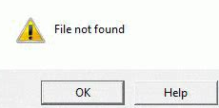

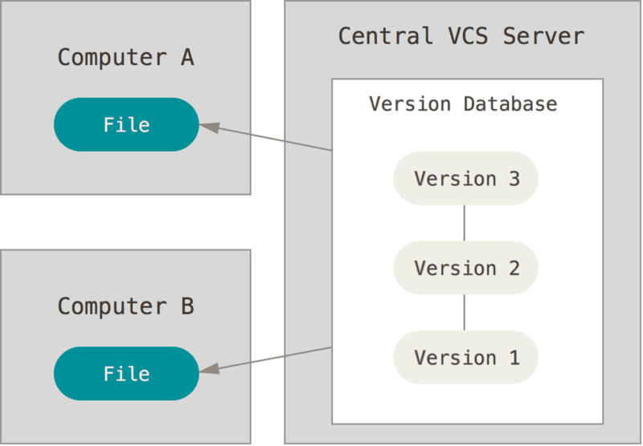

Backing Up Data and Version Control
Computer devices can fail, data can be corrupted, computer devices can be lost, stolen, or destroyed. Back-up data means to make more than one copy. Backing up your data is important to secure your data.
Version control is a system that records changes to a file or set of files over time so that you can recall specific versions later. About GitHub and Git
Not a valid reason for not completing assignment
We will use Git to version code on local computer
We will use GitHub to store on a cloud server.

Slide 28
Preparation: Lab and Guided Exploration
Go to Canvas Module L02
Open participation questions and submit
Setting up Environment- What should go in your technical documentation?
Look at preparation
Work on GE01 Assignment part 3.1
What needs to go on to your calendar?
Do you need help setting up your environment?
What questions do you have about GE01?

